Slide 1
DETECTING TEXT IN IMAGES
ABUBAKAR TAHIR BALARABE

Slide 2
ABSTRACT
Early stages of image processing locate characteristics in images that are important for evaluating the composition and characteristics of items in a scene. One such element is the edge. Edges are crucial features for image analysis because they are meaningful local variations in the image. In an image, edges often appear where two distinct parts meet. Often, the initial step in extracting information from photos is edge detection. Edge detection remains a study subject of interest because of its significance. The majority of an image's shape information is contained within its edges. By first identifying these edges in an image, applying these filters, and then boosting the parts of the image that contain edges, the image’s sharpness and clarity will improve. In our paper used hybrid algorithm to detect the edges consist of X Gradient, Y Gradient and Canny edge detector, whereby appeared object edges by the best thing and made the SWT stroke width transform at the result image to appear the edges by the four face by used four angles (0, 45, 90,135), applied the algorithm at the several images and Appeared best result and precise

Slide 3
PROBLEM STATEMENT
Detecting text over simple background and formats have achieved a high level of accuracy but text detection in images has produced lower reliability this is because text detection applications make use of specific features of an appropriate image operator that produces quick and reliable detection of text as output with Stroke Width Transform, it changes the image information from holding per-pixel colour to values holding the most likely width of stroke. The structures derived are capable of detecting texts irrespective of properties like Dimensions, orientation, font and language. The OCR engine accuracy rate always drops after deploying the SWT operator, because the OCR engine was not designed to detect scanned text easily in images. Text detection has been proposed by many researchers with promising results. Unfortunately, most solutions are limited for certain formats with low reliability.

Slide 4
Aim And Objectives
Aim
Develop a more accurate methodology for text detection in images utilising the Stroke Width Transform to implement the SWT in a useful form
Objectives
Capability to descry and remove noise in images which might make text extraction difficult.
Establish a new framework for improving text in image recognition by incorporating the semantic relationships present in the text, background, objects, and scene data.
K-d tree mechanism will be applied in the text filtering stage and the canny edge detector to recognize a variety of image edges.
Ability to evaluate the effectiveness and functionality of the recommended algorithm; Stroke Width Transform (SWT) which can further be used in the factual development of OCR software.

Slide 5
Relevance of this Dissertation
Consequential terminology in computer vision and digital image processing. Detection of the edges is in the foreground of the image processing for detection of the objects; therefore it is conclusive to require a good understand of the detection edges operators. In the existing study, comparing analyses of method of edge detection in image processing are presented. It noticed that performance of the canny edge detector is the best from the Sobel operator, Prewit operator, Robert operator and Laplacian of Gaussian).
The previous studies for detection of the edges some are established on fault minimization, some are as maximize for object function, some are used as neural network, some are used fuzzy logic, some are used wavelet methods, some are used Bayesian methods, some are used morphology and some are genetic algorithms. The proposed algorithm detects the edges by canny edge detector and SWT.

Slide 6
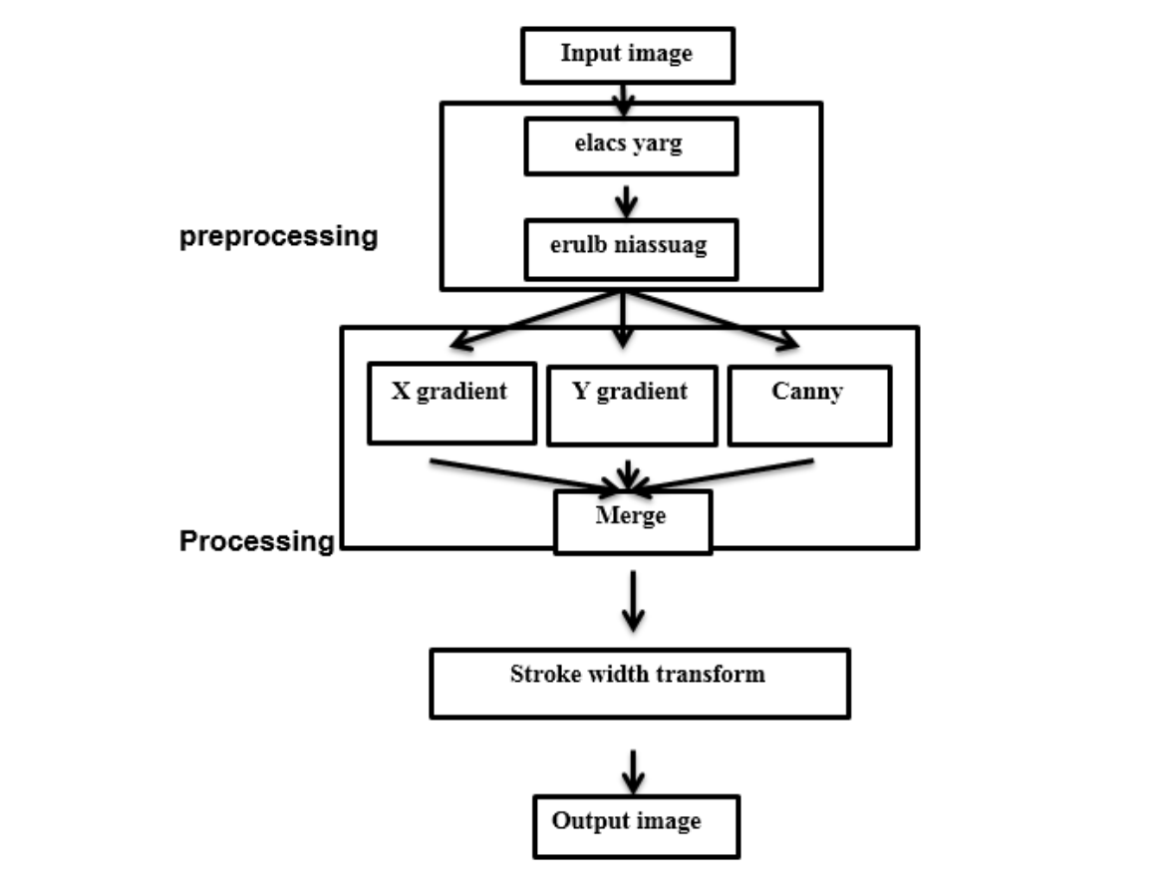
FLOWCHART FOR PROPOSED ALGOLRITHIM

Slide 7
PRE-PROCESSING
In this step will make preprocessing for the image to remove it the noise and blur for image, the preprocessing consists of two steps:
Step one:
In this step will take a natural image and converted it to the gray scale by applying filters for conversion as shown in the figure.
Step two:
in this step will take output image for step one and apply Gaussian blur for reduce the noise that find on the image and blur for the image that the mask be on the several type. Smoothed of this image can be completed by the convolve the input image I(x, y) with a Gaussian kernal G(x, y) that achieved by which obtain by computing the sum of products the pixels among the input image and a Gaussian kernal of the size (3×3) or (5×5).Then we will choose the best from the image to determine the kernel size and the value of sigma, then found that the best image when used size of kernel is 7×7 and the value of sigma is 0.1.

Slide 8
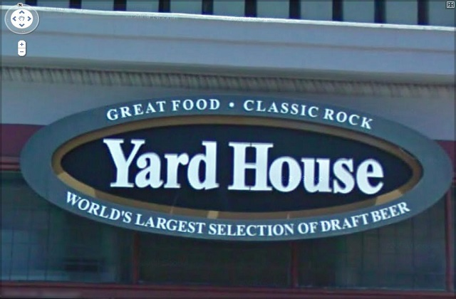
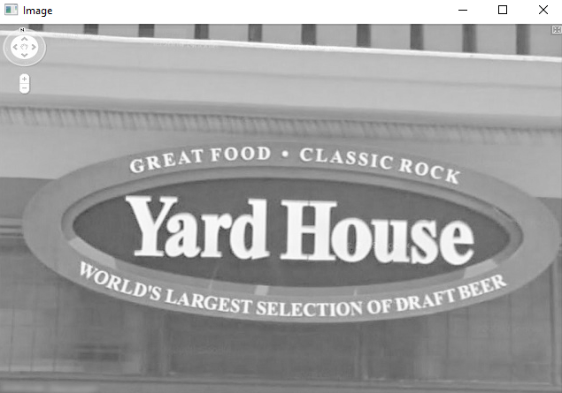
INPUT IMAGE
GREY SCALE IMAGE

Slide 9
PROCESSING
The processing consist of three steps
Step one: X gradient, Y gradient
Find X gradient, Y gradient for the image by computing the gradient and intensity for each pixel in the image. The image is convolved with both kernels that previous mentioned earlier to approximate the derivatives in horizontal and vertical change as shown in the algorithm
Step two: Canny edge detector
Apply canny edge detector by applying sobel filter to the X, Y gradient for edge detection by using Equ (6). Then apply Gaussian operator to detect the edges and find two thresholds to
detect accurate edges for the image as shown in the algorithm
Step 3: Merge
In this step will be merge the result image that produced from X,Y gradient and canny edge detector by addition equation to detect the edges by the best manner to produce the best edges
as shown in the figure

Slide 10
CONNECTED COMPONENTS
In order to scan for text, connected component procedures look for homogeneous blobs of pixels. These techniques often include running an algorithm on a picture and categorising pixels based on the results. These algorithms frequently look for distinct letters before clustering them to create text lines rather than looking for words or text-filled areas.
By employing connected component labelling, also known as connected element analysis, blob
extraction, or regional labelling, you may determine whether or not "blob"-like regions in a binary image are connected While connected component labelling frequently enables us to more precisely filter the binary image's blobs, connected component analysis is frequently applied in the same circumstances as contours. When using contour analysis frequently, we are constrained by the outlines' hierarchical structure. Using linked principal components analysis, we can divide and evaluate these structures more quickly.

Slide 11
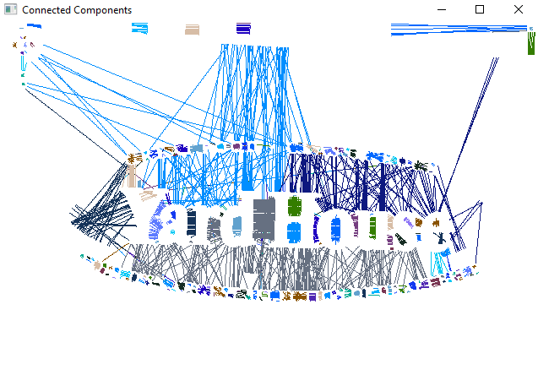

Slide 12
STROKE WIDTH TRANSFORM
Find SWT for each pixel for the merge image by different angle (0, 45, 90, and 135) and find max min in SWT Then test the value of the stroke width with each angle and find the best value that will be the edges at the best cases and this value is consider the stroke width for that pixel. It predefine a stroke as a contiguous part of an image that formulae a band of roughly constant width. It is a local for the image laborer that computes for every pixel the width of the bulk possibly the stroke that containing the pixel. It is a general process for the job of distinguishing texts from natural images because the characters have the extended shape of closely uniform width. The output image of the SWT has the size that equal to the size of the input image where every element has the width of the width of the stroke related with the pixel. The basic impetus of the stroke width algorithm is that stroke width approximately in the text or in the single character remnants the same of this; though there is important change in the stroke width in the region of the non-text non-text [11]. The stroke as portion of the image that shapes a band of roughly width, as shown in the next image

Slide 13
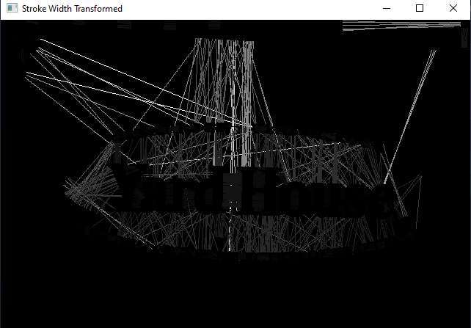

Slide 14
EVALUATION
To validate the effectiveness of our model, canny edge detector has proven to be a good detector and can protect against noise. Our evaluation relies on how we perceive information while reading text in image,text detection, and recognition as performed in the previous section however these were very well documented and standardized. This work has several potential extensions that could be implemented. By taking into account the recovered strokes' directions, the SWTLoc library may be used to implement the letter grouping. This may also help with the recognition of curved text lines.
1. Recognizing connected elements in the image by excluding areas of pixels using metrics for stroke width;
2. The components that cannot be recognised or are not thought to be related to legitimate text are eliminated from the stroke width transform algorithm examination.
3. To evaluate if neighbouring pixels are linked to similar stroke widths whose standard deviation exceeds a set threshold, the filtering evaluation in (1) must first identify those that are.
4. Linking pixels to image component widths to identify text in images, including:
(a) Identifying image elements of the aforementioned visual representation that are distinguished by conflicting elements.
(b) Drawing lines across both sides of a stroke to connect the aforementioned conflicting elements.
(c) Linking pixels along those lines to an image component's widths.
5. Edges, a non-regular grid, and depending on vector data in the image are used to depict the opposing elements on either side of a stroke.
6. The image created from the stroke width data contains elements whose stroke widths correspond to those of nearby connected components.

Slide 15
CONCLUSION
Various edge detectors have been studied. Canny evidenced is the best detector for external and internal lines of object figuration edges and has best protection to noise than Robert, Prewitt and sobel operator. The proposed algorithm performs the best than canny edge detector. In this paper, a proposed algorithm suggested an efficient approach for successful canny edge detector algorithm by using hybrid algorithm by X Gradient, Y Gradient and Canny edge detector and applied SWT at the result image .the proposed algorithm observed that the hybrid algorithm produced larger accuracy in detection of edges and the less execution time compared with algorithm of Sobel edge detection, applied the algorithm at nearly 20 images and appears the best result.

